Slide 1


Omnicom Media Group
Media Company Case Study
-By Rupinder Kaur

Slide 2
Analysis of Decline In Viewership of TV Show
The analysis has been done for approximately 2.5 months starting from 3/1/2017 until 5/19/2017 for a TV show
During the period, it has been analysed that the factors that impacted the shows growth is due to seasonality, majorly impacted by the column “Character A” and slightly due to cricket.
It has been observed that visitors > views_show
As the viewership of the show declined, it seems like the marketing budget for ad-impression also got declined.

Slide 3
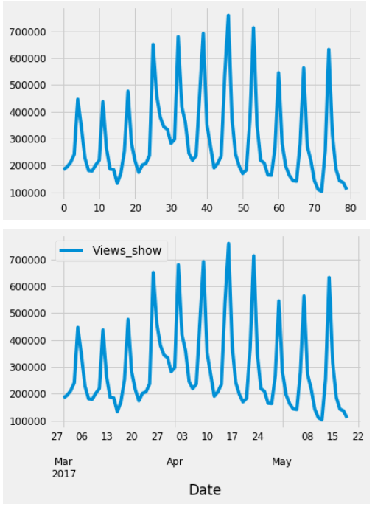
Data Analysis with Charts
Views_Shows
In March, its up then a broad jump towards end of March
In April, it is seen as a period of growth as in the middle of April, it is the highest then little fluctuations towards end of April
In May, there is a sudden drop

Slide 4
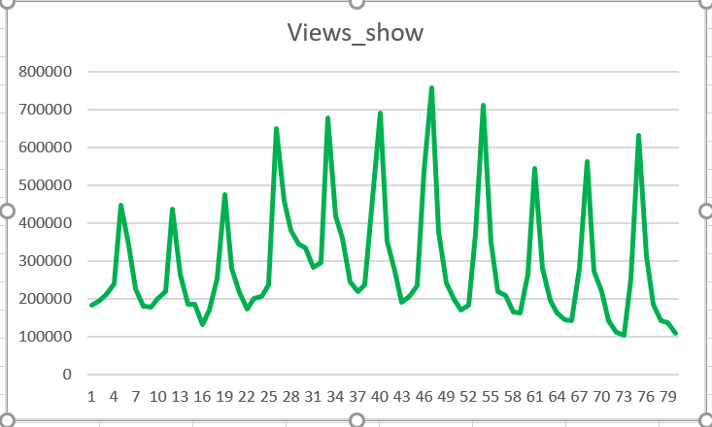
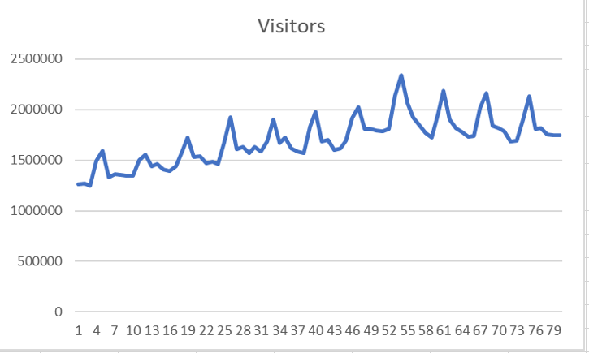
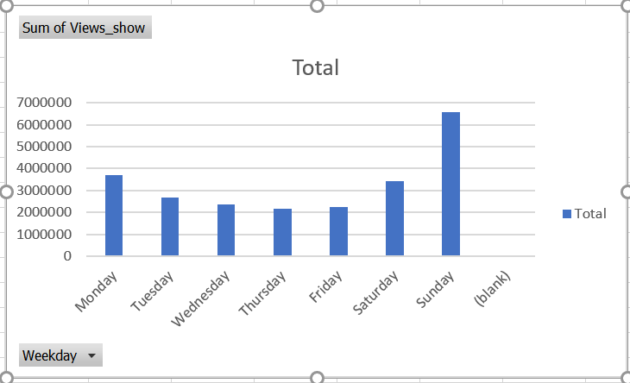
It has been observed from the charts that visitors are greater than views_show
It has seen that there’s seasonality in the data.
On weekend, it’s slightly up as comparatively to weekdays.
In the middle of week, it has been least watched on Wednesdays and Thursdays.

Slide 5
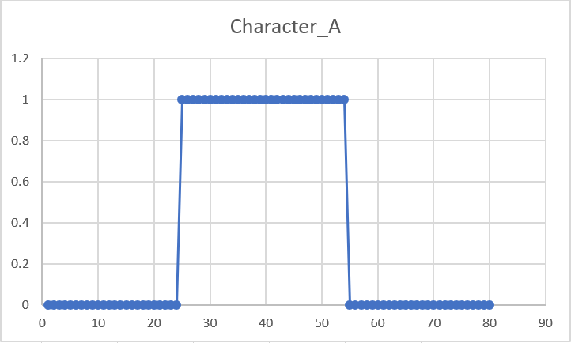
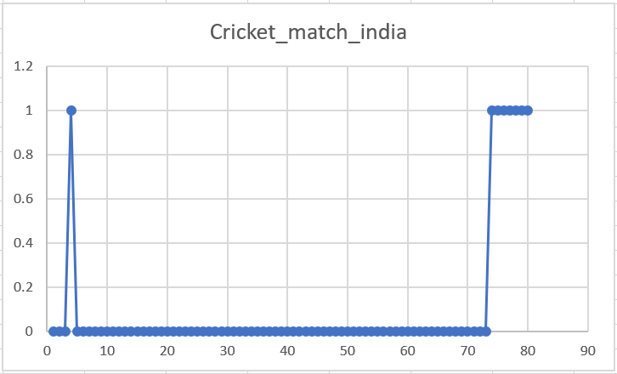
The major impact of show’s viewership decline is due to Character_A. The show has seen growth when the Character A was there and it got declined as the Character_A gone.
Cricket_match_India doesn’t have much impact on the viewership of the show.

Slide 6
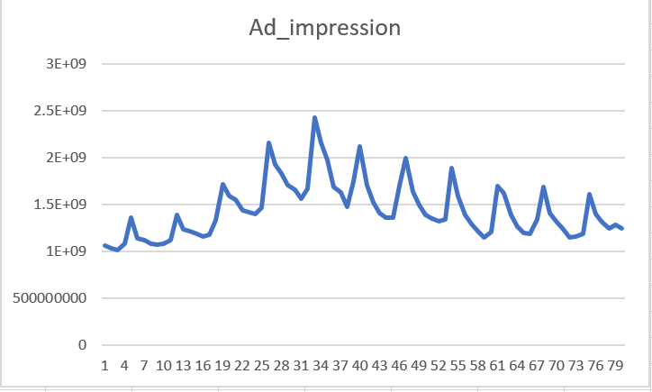
As the viewership of the show declined, it seems like the marketing budget for ad-impression also got declined.

Slide 7
ARIMA MODELLING FOR FORECASTING
Known as AutoRegressive Integrated Moving Average
P — Auto regressive feature of the model
D — Differencing order
Q — Moving average feature of the model

Slide 8
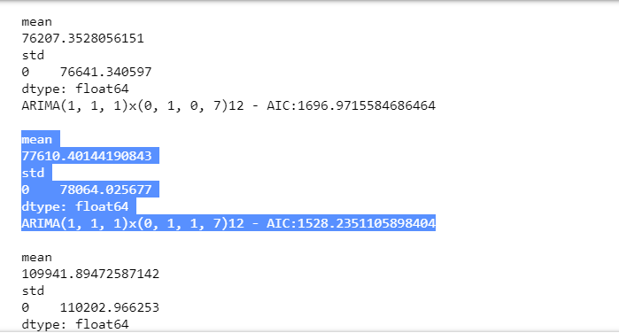
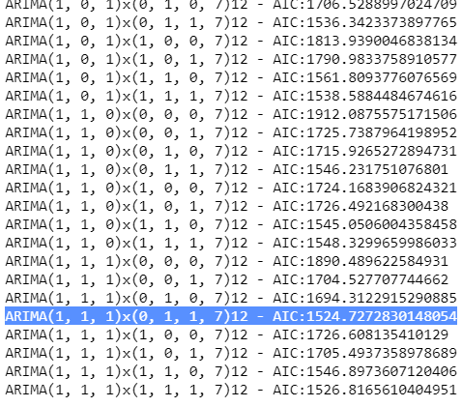
The combination which is best and optimal fit for the model is (1,1,1)*(0,1,1,7) with lowest AIC is 1528 but with a slightly higher mean 77610.

Slide 9
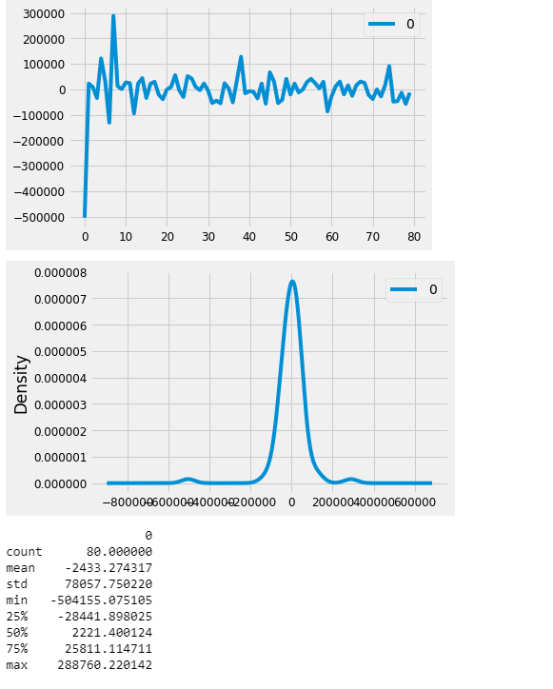
Residual Error
Residual error: The mean is clearly close to 0 so it reflects that the model is not biased.

Slide 10
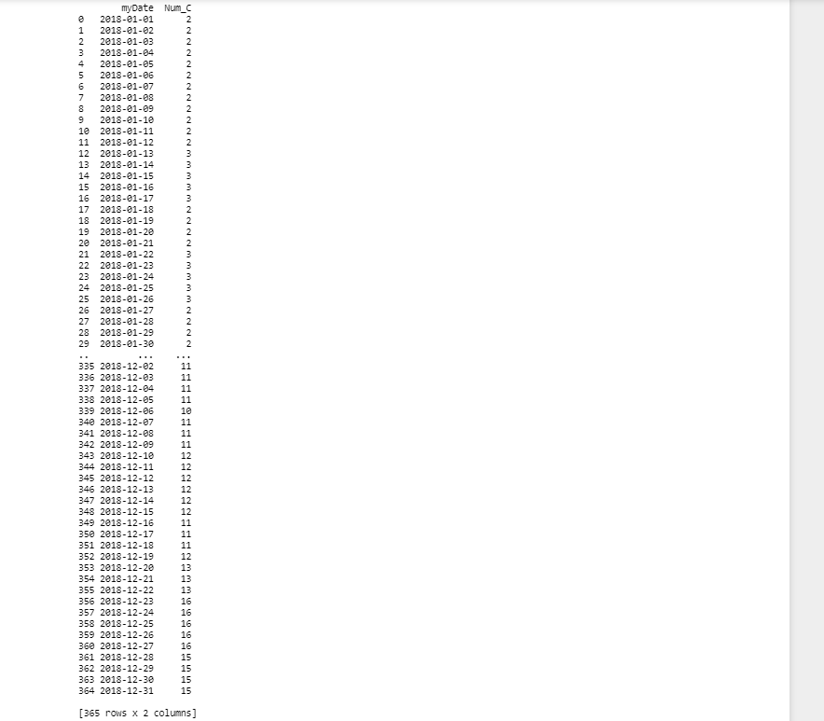

Slide 11
Future Improvements
An expected improvement in the p value of Character_A and Cricket_Match_India

